Slide 1

Optimizing similarity search
between images
Semester Project
Notes:
Good afternoon everyone, for those who don’t know me my name is Guillaume Raille and I have been working with the LSIR (Distributed information Systmem Laboratory) on Optimizing similarity search between images as my semester project.

Slide 2
Outline
Introduction
Methodology
Experimental Setup
Results
Conclusion
Notes:
In this 10 minutes presentation I will first introduce the project and its purpose then I will explain the methodology and the experimental setup we used, after that I will go through the results that we obtained and finally give my conclusion. So let’s begin with the introduction.

Slide 3


Introduction
Trending topic
Many use-cases
Many domains
Many researches
Image Similarity Detection
Experimental Approach
Evaluate Methods
Following a paper:
“An evaluation of large-scale methods for image instance and class discovery” 2017
Semester Project
Notes:
Image similarity detection and image processing more generally is a subject impacting today almost every sectors from robotics, automatic to agriculture and even transportation (automated cars..).
Such a trending topic and problematic of image similarity detection is of course being actively developed and researched by many scientists in many labs and team across the world.
Hence leading to a lot of solution and methods being implemented and published.
In this semester project we tried, through an experimental approach to evaluate and compare some of the state-of-the art latest methods in image similarity detection techniques. We took inspiration from a Paper “a billion scale similarity” which can even be considered as a starting point for this semester project and similarly we focused on highly scalable solution for big datasets. In order to evaluate and draw our comparison we developed a pipeline inspired from the paper just cited. The next slide will present you the so called pipeline.

Slide 4
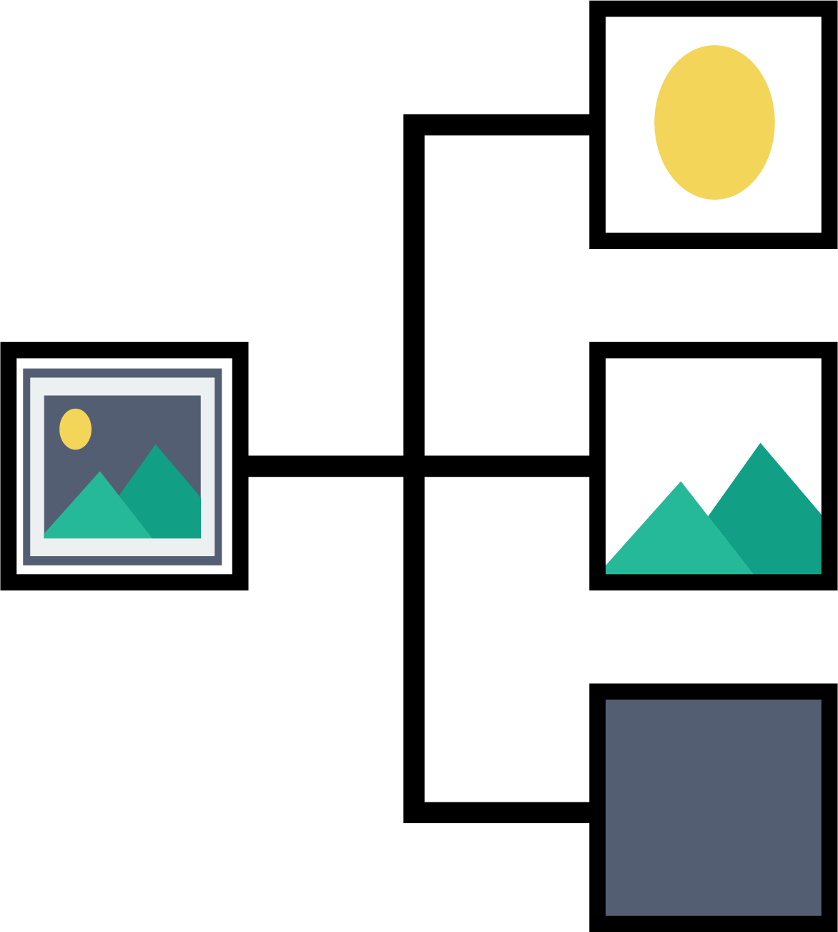
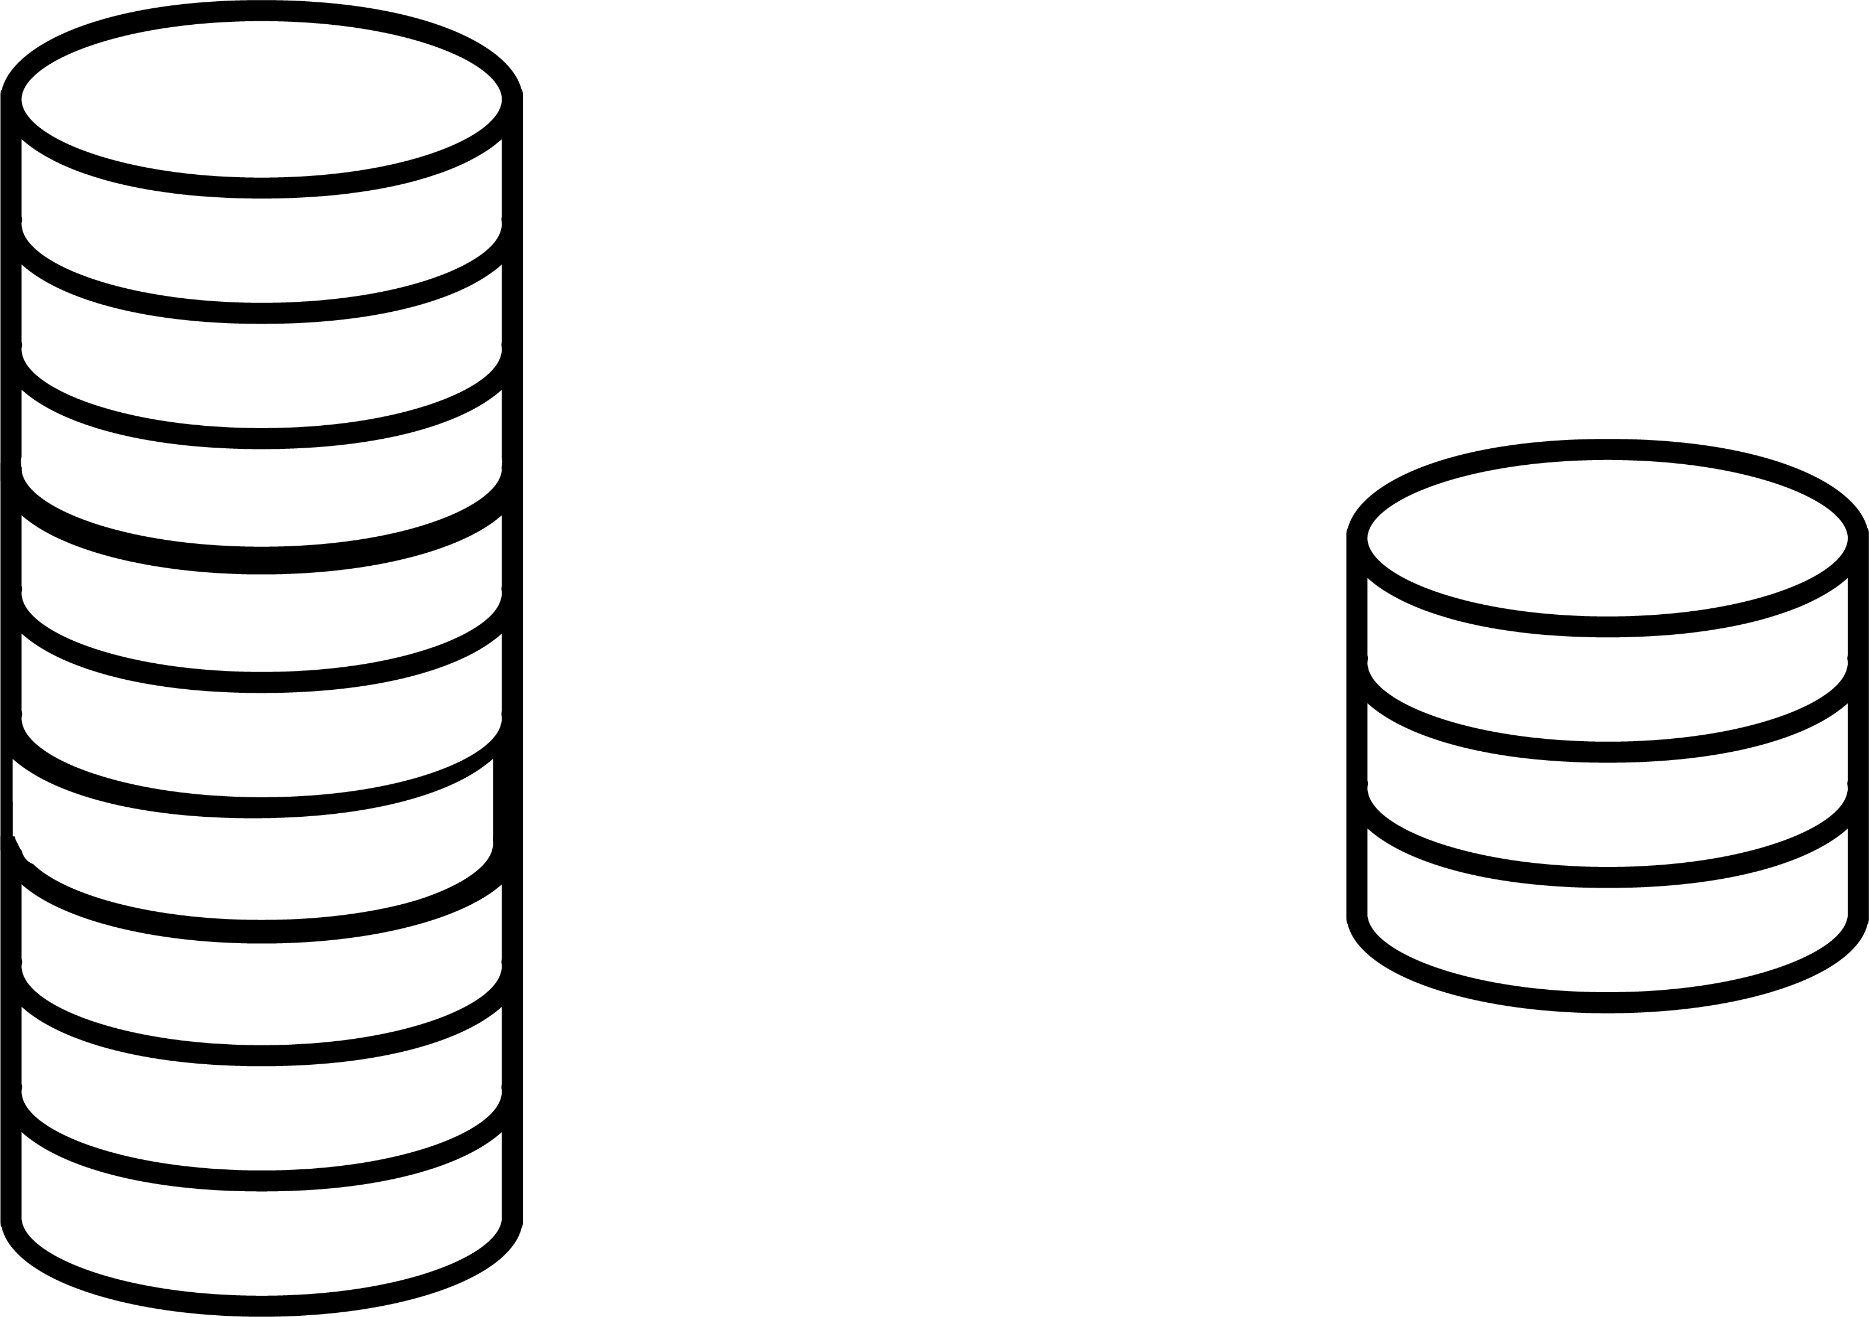

Pipeline Overview
Features extraction
PCA reduction
K-NN methods
Pre-trained C.N.N.
Transfer Learning
High-level features
512D features vector
512D to 128D
Computation Time
Memory usage
Performance
Brute-force
Annoy
NMSLIB / HNSW
Faiss
Notes:
The pipeline we used in this semester project to evaluate image similarity among images we had at hand, was designed to be highly scalable and fast to compute. It is composed of 3 steps:
A first step is the Features extraction. It takes the image as input and output a vector of features with 512D. How it does that ? Well we used for that a pre-trained C.N.N, to be more precise a resnet or residual neural network developed by microsoft and pre-trained on 2 different datasets to see the effect of pre-training (I will come back later on that). We used this CNN not in a regular way as we used it very similarly as when doing transfer learning: as a feature extractor. It means than instead of training the CNN as usual, we used fixed or frozen weights and simply compute a forward operation in our CNN (no backprogation or gradient descent) which means that we only operate an amount of convolution, and pooling operation to our images and extract which are the value after the final layer and just before the fully connected layer. In this specific CNN this gives us a 512D features vector.
Once that step realised we proceed with PCA dimensionality reduction. Many advantages came up from this step first it obviously reduced the size of the data the momory usage was significantly reduced. Second as less data where being computed, the computation time on the reduced dataset was also greatly appreciated (it was at least reduced by a factor 3 in most cases). Finally keeping only the principal component explaining the most variance of our datas, it slightly improved the performance and the results we could obtain from the data.
Finally the last step was to apply a k-NN method to find similarity between the features wich eventually meant similarity between the images. We evaluated and compared four method during this semester project. First we implemented our own brute-force method on GPU, then we used Annoy a CPU library for approximate k-NN search using random projection developed at Spotify, we also used NMSLIB a toolkit to evaluate and compare different k-NN method also providing implementions of the method. In our case we only tried the most promising one from their library: HSNW (Hierarchical small navigable world). This a very performant full graph based approach with multiple layers. Finally we used the faiss library developed at Facebook AI specifically designed to perform k-NN search at billion scale. We used Faiss for its brute-force method on GPU as well as its approximate method using product quantization.
Now that we presented the methodology we used or the pipline, the next 2 slides will show you how we implemented this methodology and what did we used in practice through our experimental setup.

Slide 5
Experimental Setup – Datasets
Dataset for features extraction
ImageNet
Places365
(ImageNet images)
(Places365 images)
Dataset for evaluation
COCO
(COCOdataset images)
Notes:
This semester project required the use of large datasets for two main purposes. First as I described when I was explaining the features extraction, we used a pre-trained CNN and obviously it was trained on large images datasets: the two we used were ImageNet and Places365.

Slide 6
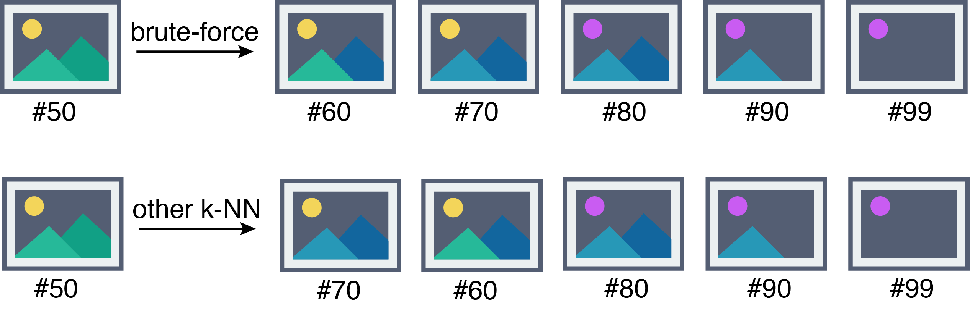
Experimental Setup – Evaluation Metrics
Similarity with brute-force
Strict Similarity (3/5)
Permissive Similarity (5/5)
BLEU score
['A bowl full of broccoli with spoons on a table.',
'A bowl that has broccoli and spoons in it.',
'A white bowl filled with broccoli and a couple of spoons.',
'A spotted glass bowl contains spoons and broccoli.',
'A bowl is filled with fresh chopped broccoli. ']
COCOdataset image and its captions.
Notes:
Bilingual Evaluation Understudy

Slide 7
Results
CPU methods
Annoy
~ 37 seconds (Strict Similarity > 80%)
NMSLIB / HSNW
~ 6 seconds (Strict Similarity > 80% )
GPU methods
Our own brute-force
~ 3 minutes 38 seconds
Faiss
Brute-force: ~ 0.63 seconds
Approximate: ~ 0.81 seconds (Strict Similarity > 80% )
Notes:
Why brute-force faster than Approixmate with Faiss ?

Slide 8
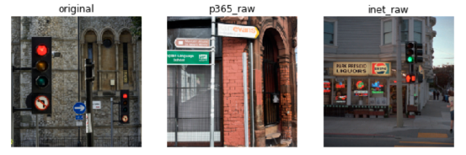
Training Set Analysis
Influence of pre-training
Similarity ~ 1%
BLEU score higher with ImageNet
Visualization on a subset

Slide 9
Conclusion
Thank you for your attention.
Notes:
Nice experimental overview, more could have been done (testing other method NMSLIB..) or

Slide 10
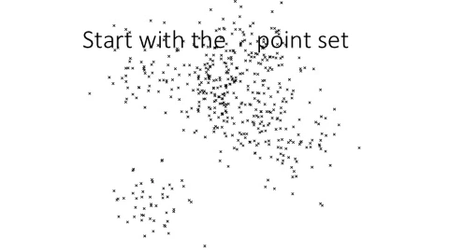
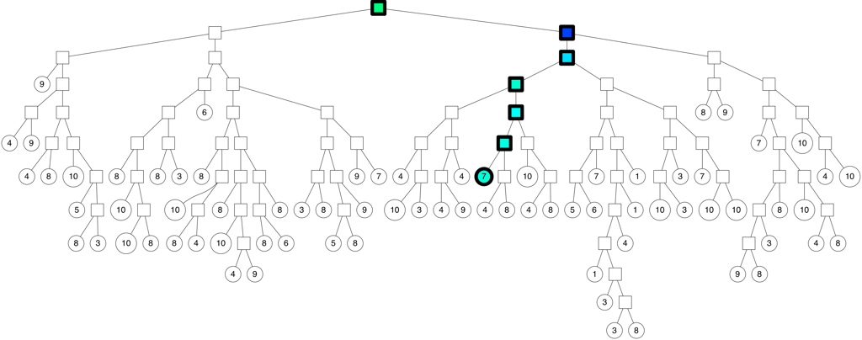
Annoy
Searching the tree
search time reduced from n to n/K
Parameters we tuned:
searchk
ntree

Slide 11
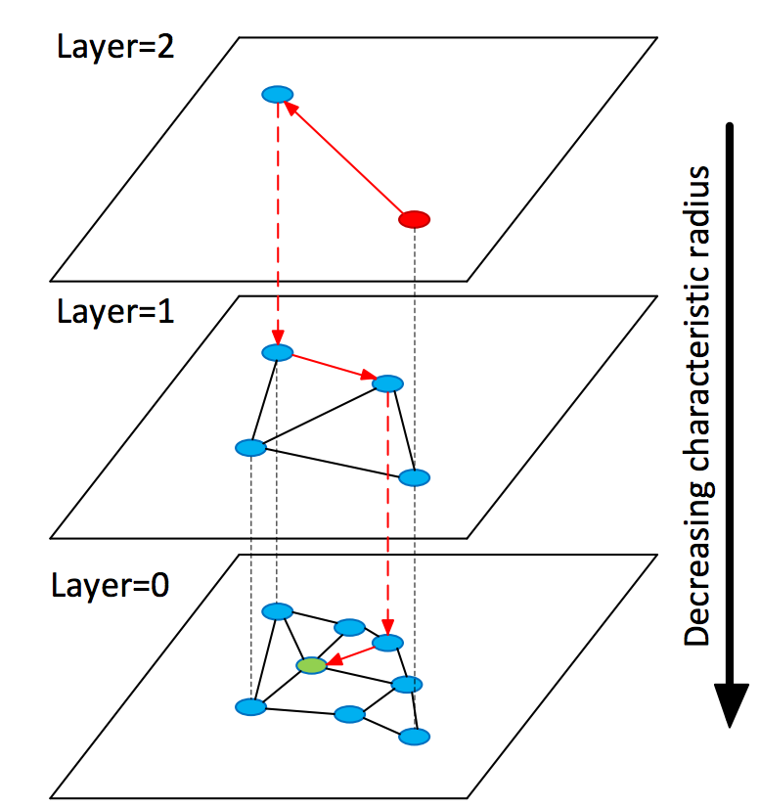
HNSW
“Hierarchical NSW incrementally builds multi-layer structure consisting from hierarchical set of proximity graphs (layers)
for nested subsets of the stored elements.”
Parameters we tuned:
M
efConstruct
ef
https://arxiv.org/pdf/1603.09320.pdf
Notes:
Construct layers of proximity graphs by specifically inserting element on different layers through greedy heuristic algorithms.
New insertion starts from the top layer, greedily traversing the graph in order to find the closest neighbor in the layer. Local minimum => use this point as entry point in the next layer. A list of ef closest of the found elements (initially entry points) is kept during the search (list always updated during the search). First phase of the search ef=1 => greedy search when the search reaches the layer equal or less than level (each inserted element as an integer maximum layer level randomly selected) ef = EfConstruction => higher recall of the greedy search procedure.
Search starts from the top layer, then greedy algorithm red until the green point (query point)
M maximum connection an element can have on each layer
efConstruct size of the dynamic list when the algorithm reach the good layer (level)
Ef size of the dynamic list to use when searching the HNSW graphs

Slide 12
Faiss
Segment the dataset into pieces (Voronoi Cells) (Product quantization)
Search only nprobe among nlist Voronoi Cells
https://arxiv.org/pdf/1702.08734.pdf
Notes:
At search time only the data contained in the X voronoi cell and few neighbours are checked reducing the number of data to check.
Another index is also required to determine which points goes into which cells = the quantizer that assign the voronoi cells. Each cell is defined by a centroid => finding the centroid consists in finding the nearest neighbor of the vector in the set of centroids.
Voronoi cells: regions based on distance to points in a specific subset of the plane.

